Slide 1
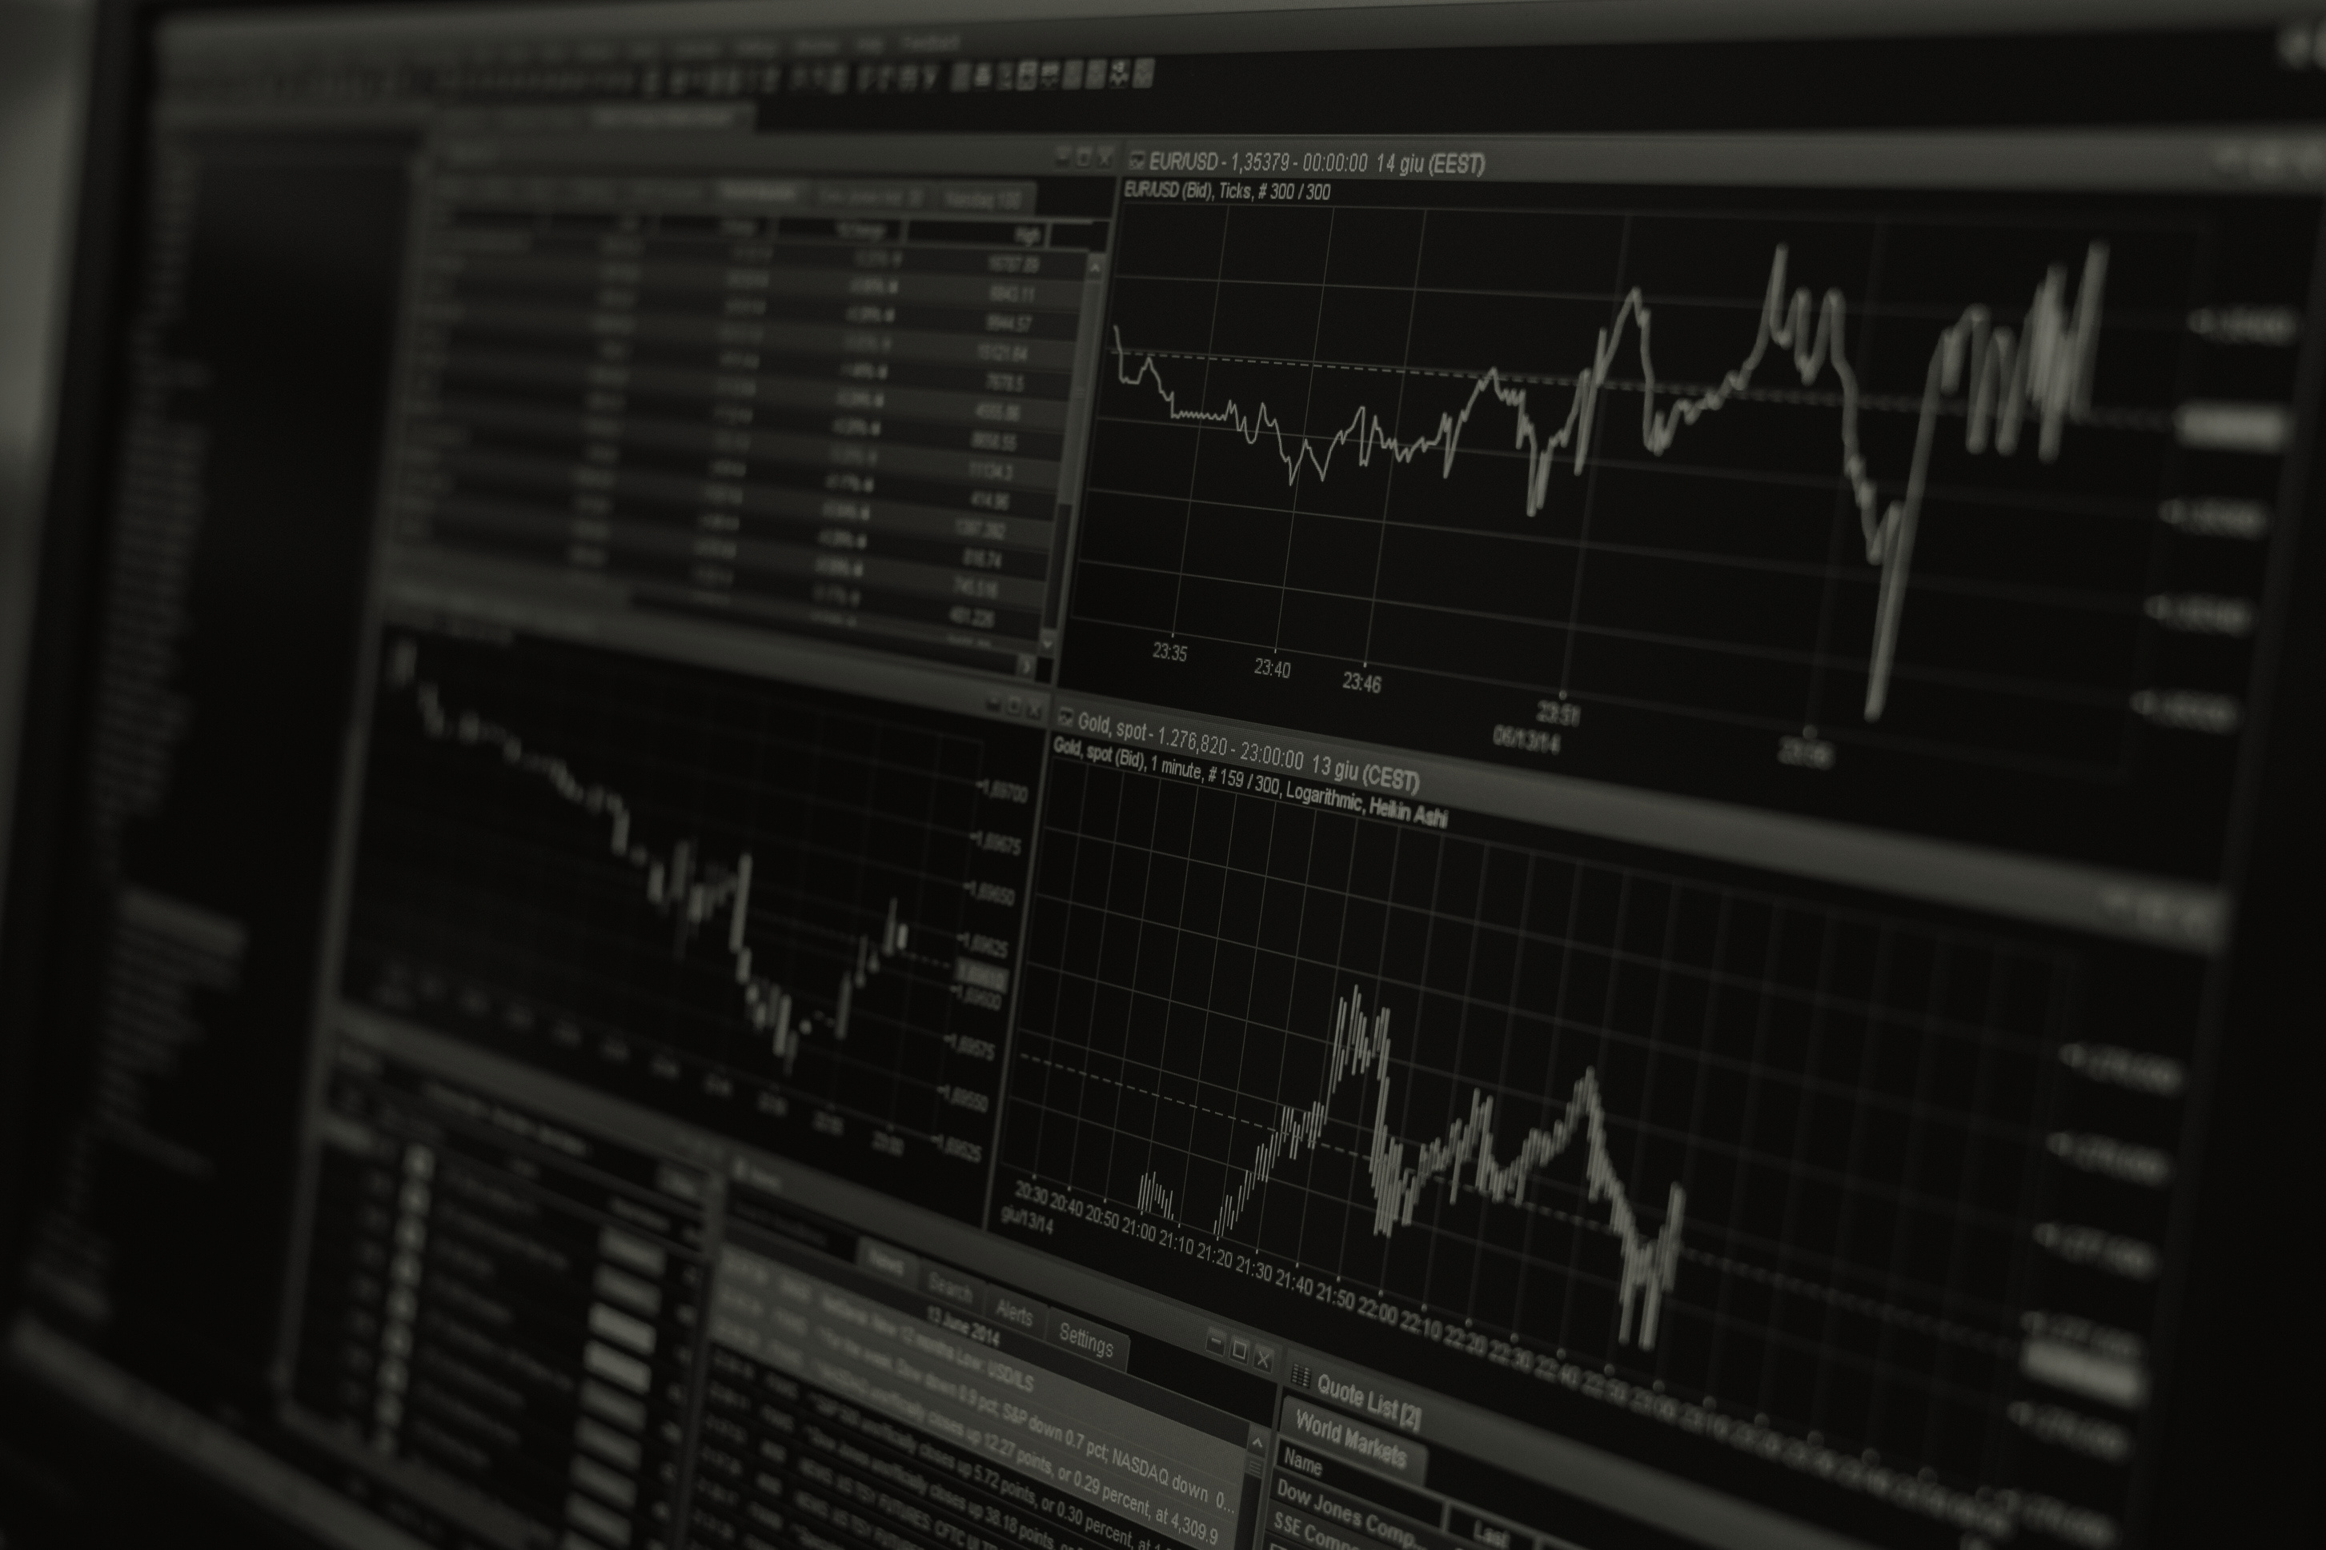
PORTFOLIO OPTIMISATION
NAGA JASWANTH 12240570 B Hari charan goud 12240360

Slide 2
PROBLEM STATEMENT:
In the world of stock markets, Optimising portfolios creates a challenge for traders in order to maximize their profits while minimizing risks. Traditional approaches often depend on static models and heuristics, which may not be suitable for dynamic markets. Hence, it is really important to find new innovative solutions that can use advanced technologies to optimize portfolios effectively. One such technology is Reinforcement Learning. The task is to develop a reliable portfolio optimization framework adapted specifically for traders using reinforcement techniques like Q-Learning.

Slide 3
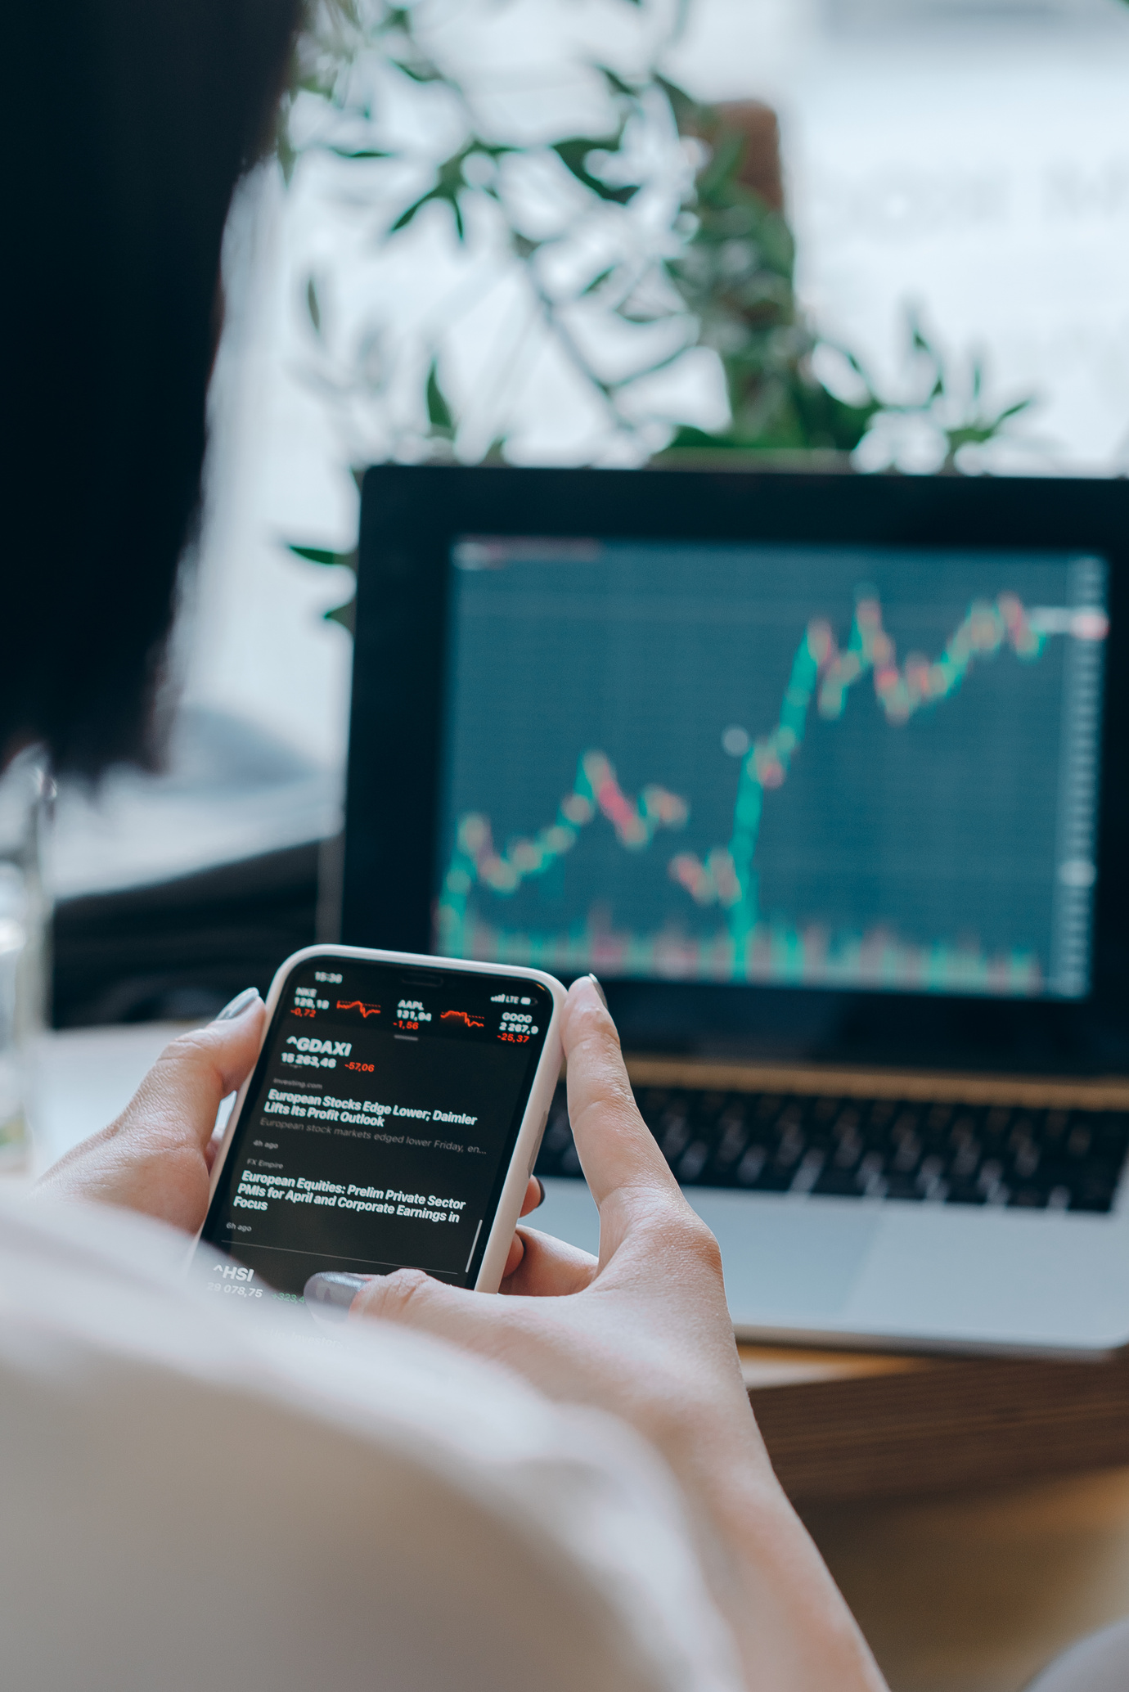
OVERVIEW:
The goal of this project is to perform trade analysis on the historical stock market data of several stocks and optimize the financial portfolio of an investor.
LSTM neural network architecture is used to train the data
Deep Q-Networks (DQN), a form of Reinforcement Learning, are employed to optimize the portfolio using historical stock market data trends. Through training the DQN model on past data, an optimized portfolio model is generated. This approach allows for refining portfolio strategies and improving performance based on learned insights

Slide 4

Data collection and preprocessing:
The dataset consists of historical stock price data, which includes opening, closing, high and low prices, as well as volume information.
The dataset collected is split into two, Training data and testing data.
Training data comprises the stock data recorded before 2024 for each individual stock.
The stock data from the beginning of 2024 is used for testing and evaluation.
The data is preprocessed to handle missing values, normalize features, and generate sequences suitable for LSTM input.

Slide 5
LSTM stock price prediction:
Traditional RNNs suffer from the vanishing gradient problem, limiting their ability to capture long-term dependencies in sequential data like stock prices.
LSTM (Long Short-Term Memory) networks overcome this limitation by introducing a more complex architecture with specialized memory cells and gating mechanisms.
Using LSTM neural network architecture, the future stock prices for a single stock are forecasted.
The LSTM model learns from the temporal patterns and dependencies in the training data to make accurate predictions for future stock prices.

Slide 6
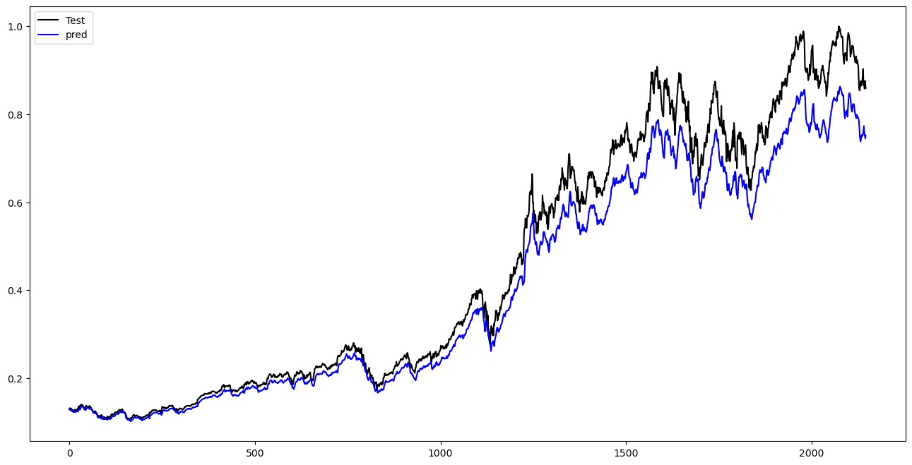
Predicted movement of closing prices of AAPL stock with a lookback of 30 days.

Slide 7
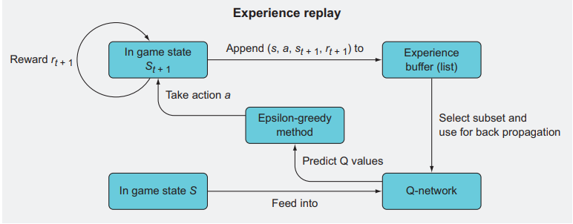
DEEP Q-NETWORKS:
In the DQN framework, the Q-function is approximated by a neural network, allowing the model to estimate the expected cumulative rewards associated with taking specific actions in different states.
Based on the predictions of Q-functions, the model determines the optimal actions to take in a given state.

Slide 8
State space: A k*1 matrix with each term as the Difference between predicted tomorrow’s stock price and todays stock price (closing price_{t+1}-closing price_{t}) for k number of stocks.
Actions: Buy, sell, hold.
Reward: Profits earned by performing optimal actions for the given state space.

Slide 9
Evaluation and Testing:
The combined Q-learning and DQN framework is trained using historical data to learn optimal actions for each stock daily.
Testing involves applying the trained model to unseen data, making real-time buy/sell/hold decisions.
Portfolio construction:
A model portfolio is constructed based on the decisions generated by the trained model.
The portfolio table consists of rows representing dates and columns representing stocks, filled with the corresponding action for each stock daily.

Slide 10
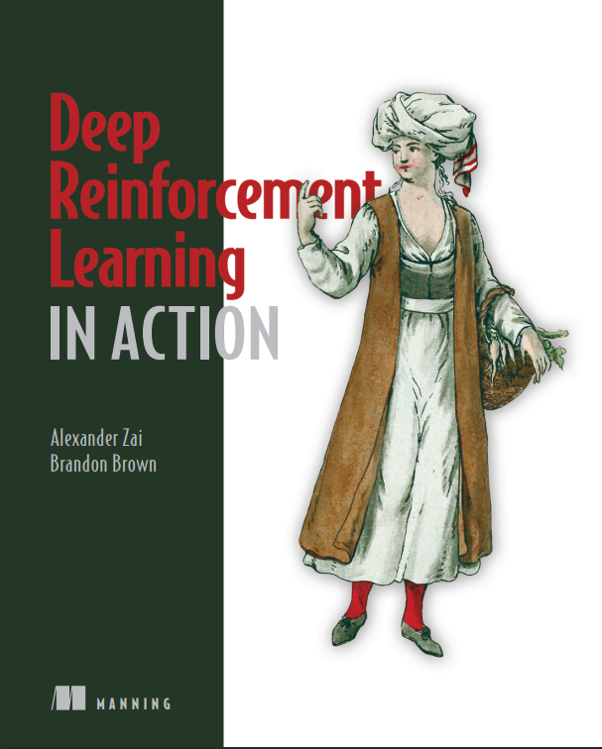
References
BOOK: Alexander Zai and Brandon Brown(2020), Deep reinforcement Learning in Action, Manning .
Youtube channel: https://www.youtube.com/@CodeTradingCafe
List down your reference here

Slide 11



THANK YOU !

